Slide 1
Summer Training Evaluation
Project: Coupon management service
https://github.com/umutulasaydin/Internship

Slide 2
What Did I Know Before The Internship?
Many programming languages and frameworks (React, Django, Flutter, PHP, C++)
Various Databases (Firebase, MongoDb, MySQL)
Used some terminologies and technologies by taking part in various projects.
However, there is insufficient technology and application development for the end user.

Slide 3
What I Learned During The Internship?
Backend Terms and Technologies:
ASP.NET Core basics, Dependency Injection, Middleware, API, Controller, Database connection, Authentication, JWT Token, Logging, Cache-in Memory, Refresh Token, Salting, Swagger, Postman, Dapper, Base Request, Base Response, Layered Architecture, Nlog, Fluent Validation, X-Api-Key, Services, Repositories, Transaction SQL, Stored Procedures, Rate Limiter, Paging, Sorting and Filtering with SQL Stored Procedures, Quartz, Memory Monitor, Enum, Prometheus, Grafana, App Metrics, Monitoring, Localization
Frontend Terms and Technologies:
Angular basics, Component, Event, Directives, Services, Interceptor, Custom Service, Responsive Layout, KendoUI, Grid Binding, Paging, Sorting and Filtering with KendoUI Grid, Localization, Session Storage
General Terms and Technologies:
Waterfall-Agile, Tech-debt, Non-functional Requirements, DDD, Sync-Async, Bounded Context, Aggregates, Tactical Patterns, Clean DDD, Hexagonal Architecture, Microservice Communication, API Gateway,

Slide 4
Project Requirements
The person who logs in must be able to create a coupon.
It should be possible to create the coupons and it can save as draft.
There should be a dashboard page.
Coupons must have 5 statuses: active, used, blocked, draft and expired.
Coupons can be blocked or unblocked.
Coupons can be void and redeemed.
Coupons can be deleted.
Series can be created.
Series should be able to filter and sort.
Series should be able to be deleted.
Logs should be able to filter and sort.
User information must be accesible.
Coupon code must be unique.
There must be authentication in the project.
There must be validation when logging into the project.
Login must be provided with JWT token.
The password should be kept secure.
Logging should be done.
Log files should not be more than 50 MB and should contain a maximum of 5 files.
All requests and responses must have the same structure.
Illegal requests must be prevented.
Backend performance should be monitored.
There must be localization throughout the system.
Frontend must be responsive.
It should be paging.
It must be a Single Page Application.

Slide 5
Used Technologies
ASP.NET Core 6.0
Angular
Prometheus-Grafana
JWT Token
Nlog
GUID
Postman
Dapper
Fluent Validation
Rate Limiter
Localization
Interceptor
Session Storage
KendoUI

Slide 6
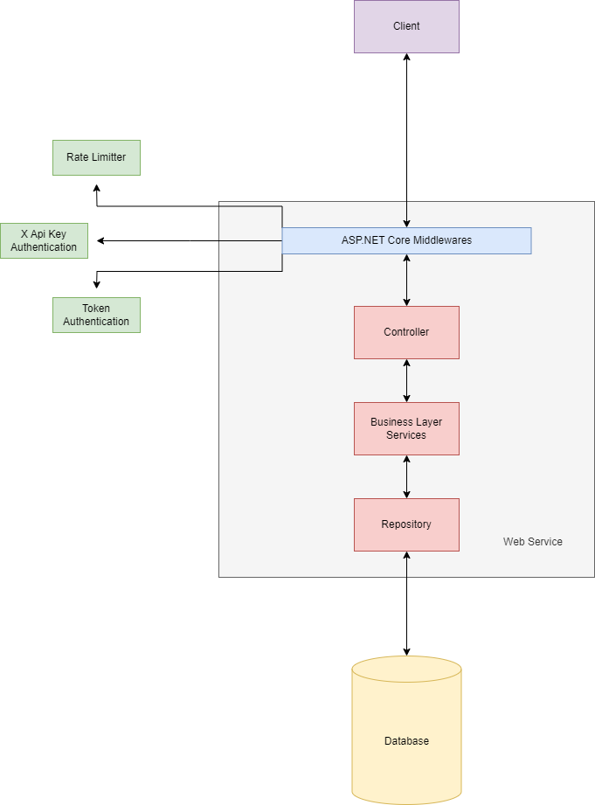
Architecture

Slide 7
Before Demo Feel Free to Ask Questions

Slide 8

DEMO

Slide 9
What can be done better?
More faster (100.000 coupons created in 77 seconds)
Ask more questions about requirements
Prevent implementing some easy ways (Causing tech-debt)
A better looking frontend

Slide 10
Any Questions?

Slide 11
Thank you for nice internship period

